Slide 1

National Transit Database 27 May, 2015 Keith Gates Senior Analyst Federal Transit Administration

Slide 2
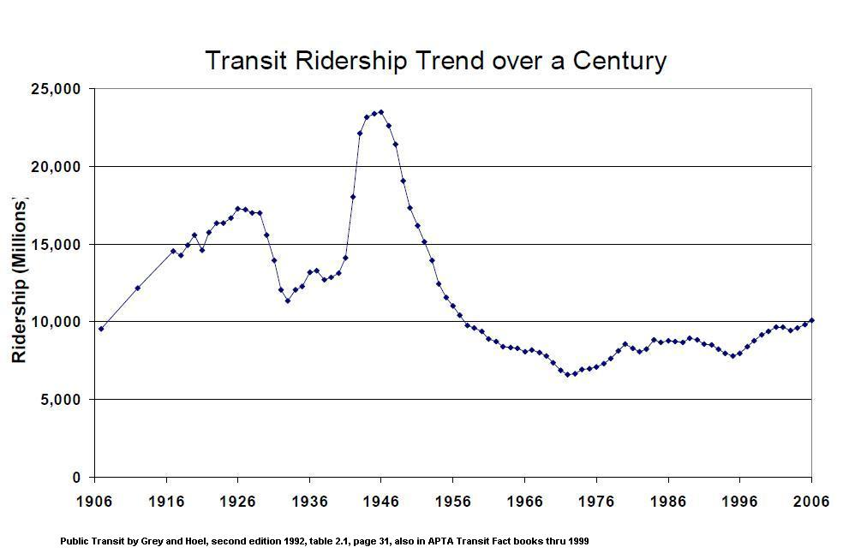
25
20
(Billions)
15
10
5

Slide 3
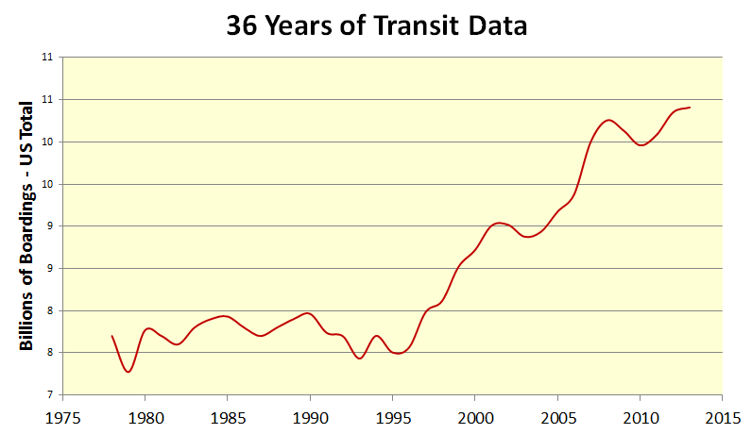

Slide 4
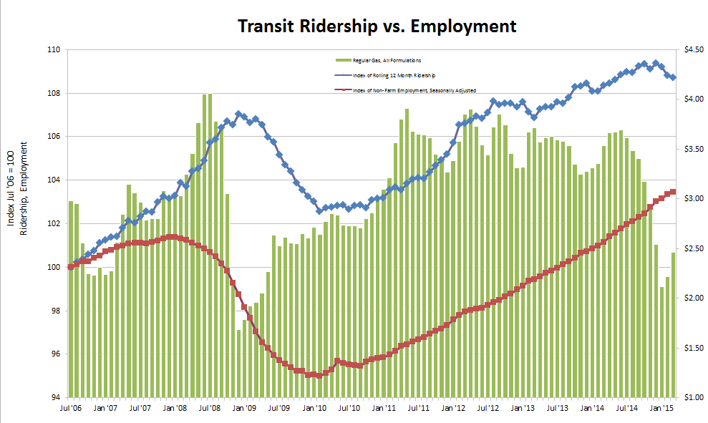
Riders
Employment
Gas Price
Monthly data from 7/06 to 3/15

Slide 5
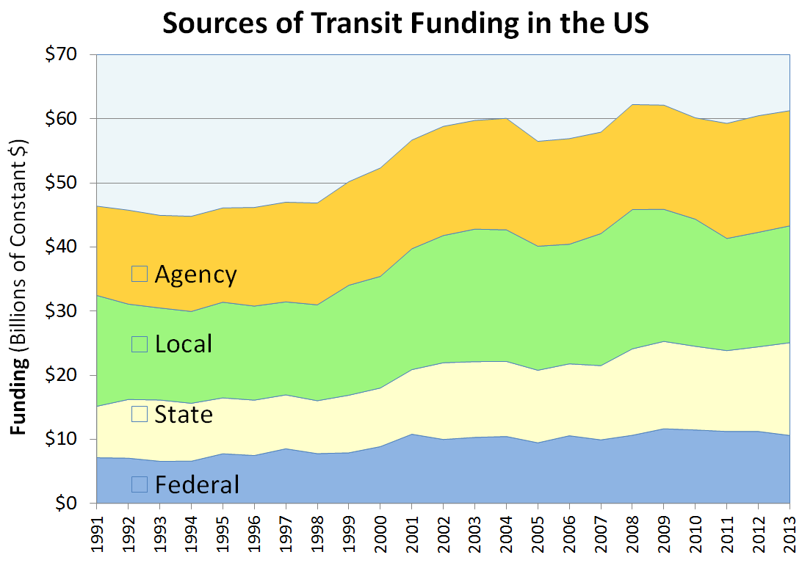
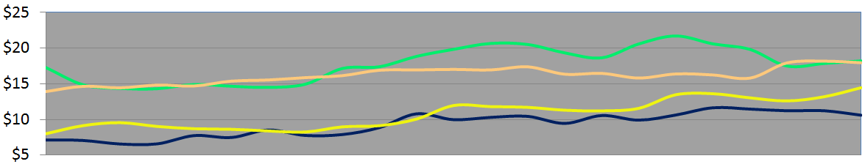

Slide 6
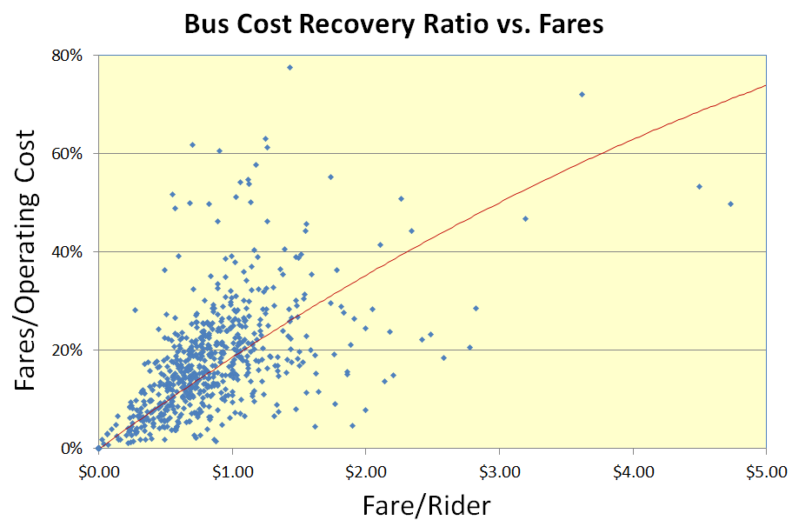

Slide 7
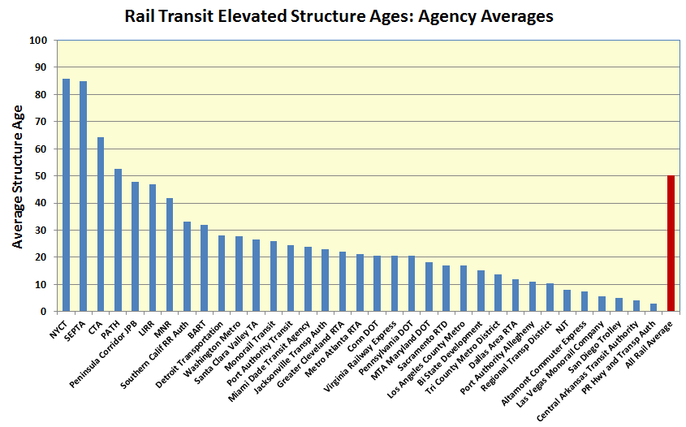

Slide 8
Capital Reinvestment Needs Forecast

Slide 9
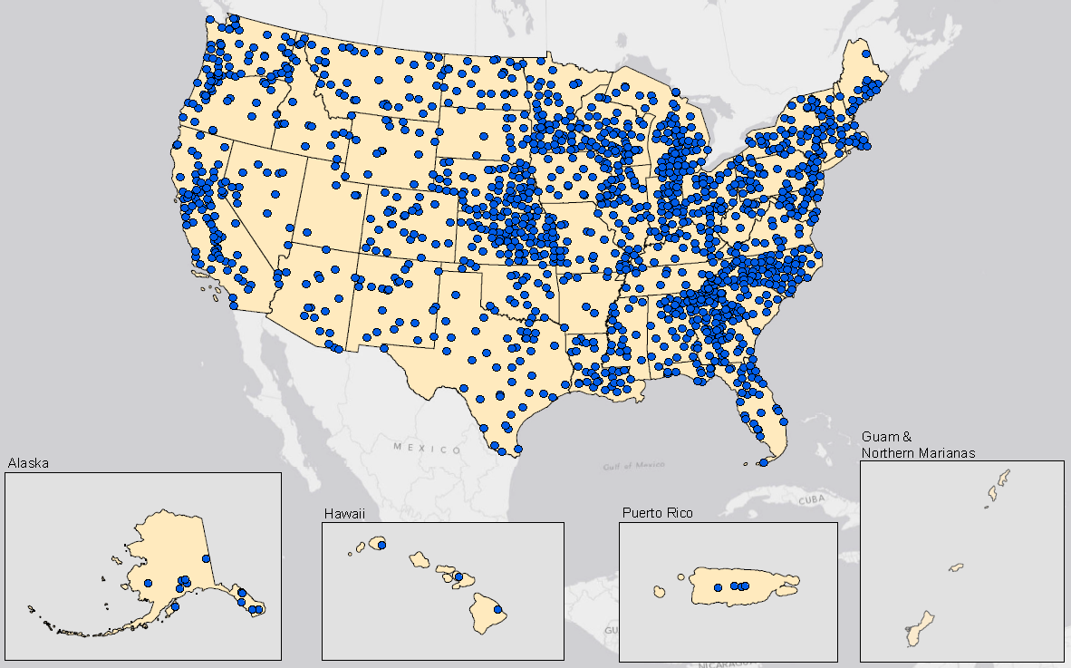
Rural Transit Systems

Slide 10
Contact Info
Keith Gates Manager, National Transit Database DOT HQ, 1200 NJ Ave. SE, DC 202-366-1794 keith.gates@dot.gov
www.fta.dot.gov
www.ntdprogram.gov

